Slide 1
CQL-Based HQMF IG
Introduction and Discussion

Slide 2
Agenda
Overview of the CQL-Based HQMF IG
Step-by-Step Comparison of QDM/CQL
Discussion and Next Steps

Slide 3
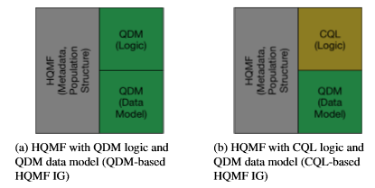
CQL-Based HQMF IG

Slide 4
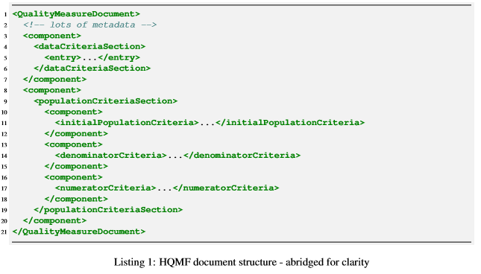
HQMF Structure

Slide 5
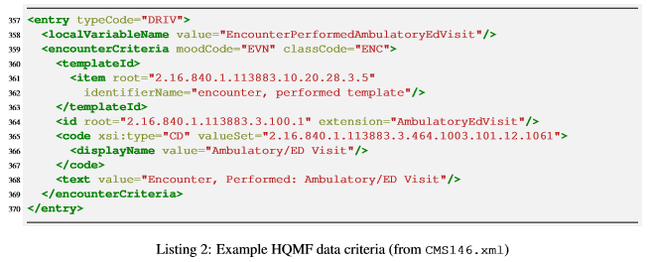
Data Criteria

Slide 6
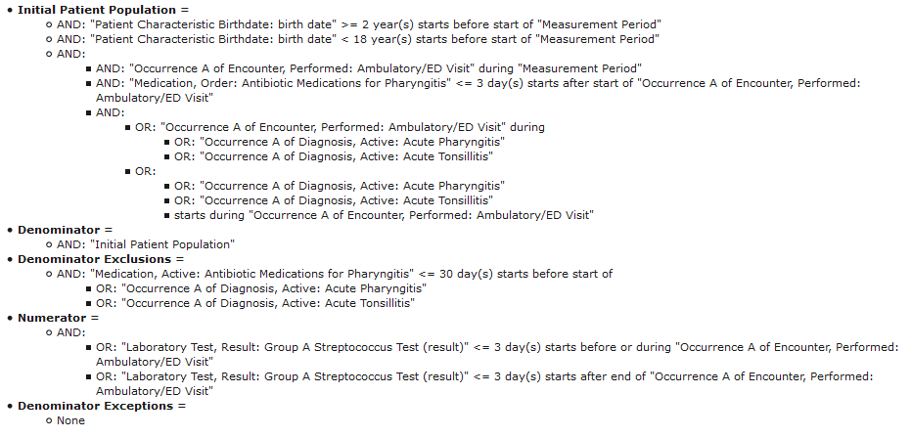
Population Criteria

Slide 7
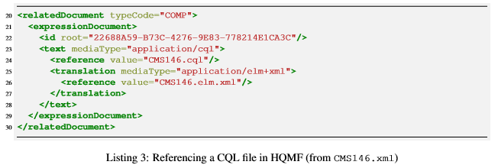
Referencing CQL

Slide 8
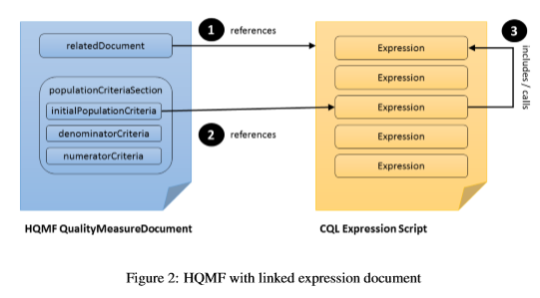
Identifying Population Expressions

Slide 9
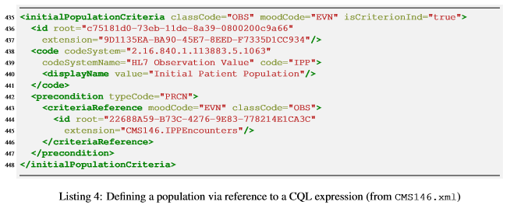
Identifying Population Expressions (cont)

Slide 10
CMS 146: QDM Population Criteria

Slide 11

CMS 146: CQL Initial Patient Population

Slide 12
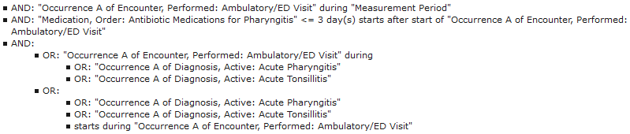
CMS 146: CQL Initial Patient Population (cont)
And, patient had an Ambulatory/ED Visit during the Measurement Period (the encounter)
And, patient had an Order for Antibiotic Medications for Pharyngitis within 3 days of the encounter
And, the encounter occurred when the patient had a Diagnosis of Pharyngitis
Or, the patient had a Diagnosis of Pharyngitis that started during the encounter

Slide 13
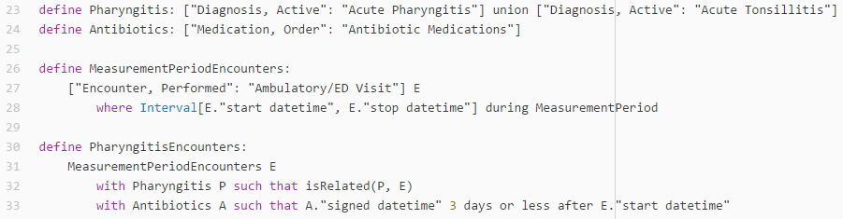
CMS 146: CQL Initial Patient Population (cont)

Slide 14
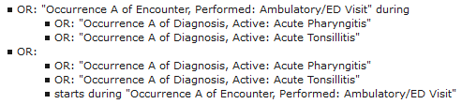
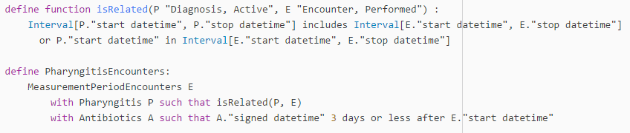
CMS 146: CQL Initial Patient Population (cont)

Slide 15

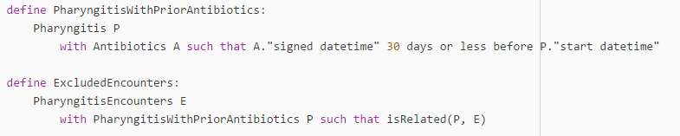
Denominator

Slide 16
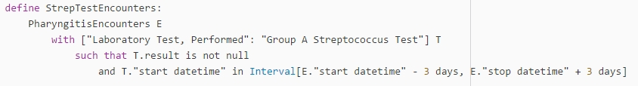
Numerator

Slide 17
Next Steps
Identify ways to clarify relationship between HQMF population criteria and CQL expressions within the HQMF document
Organize expressions by criteria within the document
Use Comments within the CQL to identify boundaries
Follow common structure for all measures
Determine CQL-style guidelines
Naming conventions
Commenting conventions
Common Patterns
Naming of expressions needs to accurately reflect the content
PharyngitisEncounters vs “Pharyngitis Encounters with Antibiotics”
Establish a pattern for how criteria are defined
e.g. Does the numerator include the denominator criteria?
Others?
Need to be careful not to introduce anything that requires inference on top of the CQL
Hyperlinks within the HQMF/HTML rendering
Also inline hints when hovering/browsing through the CQL

